Slide 1





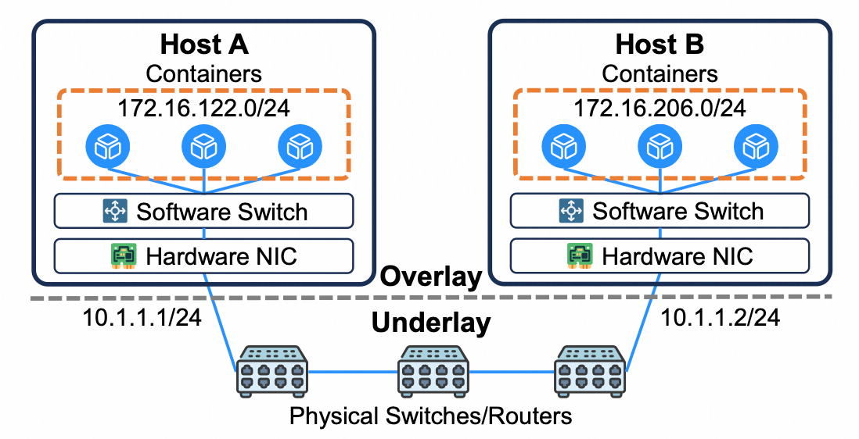
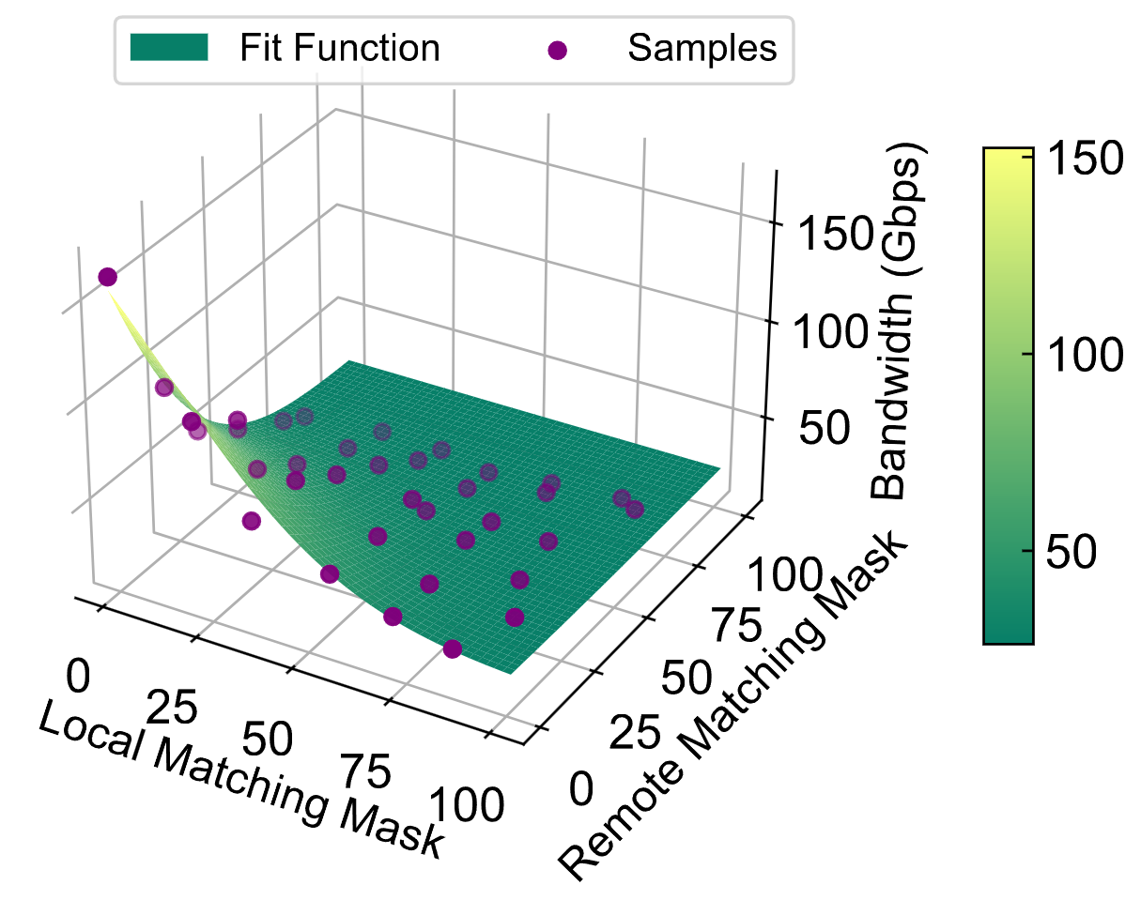
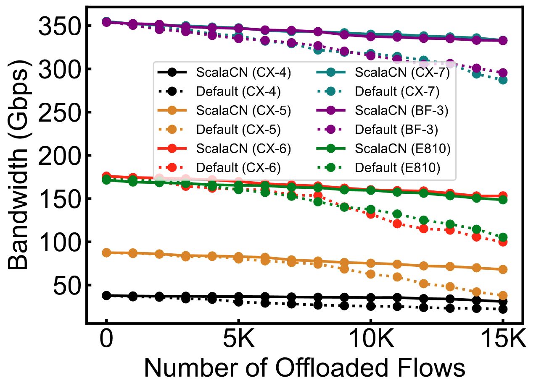
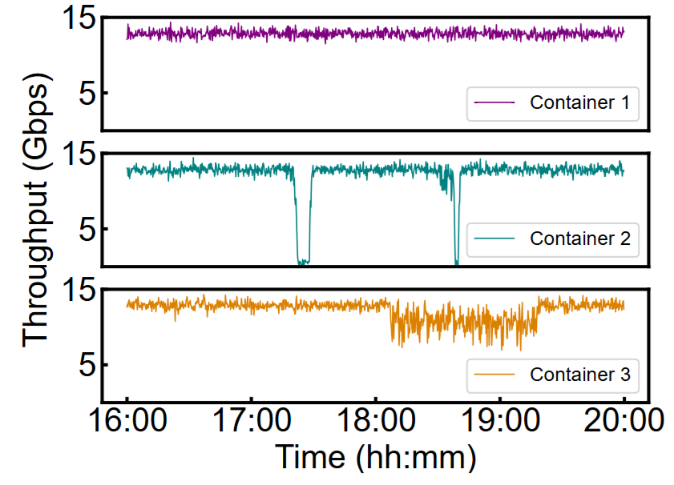
Mitigating Scalability Walls of RDMA-based Container Networks
Wei Liu, Kun Qian, Zhenhua Li, Feng Qian, Tianyin Xu, Yunhao Liu,
Yu Guan, Shuhong Zhu, Hongfei Xu, Lanlan Xi, Chao Qin, Ennan Zhai
RDMA-offloaded container networks are limited by the scalability wall of RNICs
ScalaCN: Greybox performance testing and modeling for RNICs based on Combinatorial Causal Testing
Under the scale of 0.4~0.8M containers:
The bandwidth drops by 87%
The latency increases by 34X
Deployed in Alibaba Cloud container services
40% performance improvements in production
60X speedups in RNIC performance testing

